Slide 1
MEDB 5510 Clinical Research Methods
Week 3
Literature Reviews

Slide 2
Literature Reviews
Additional Resources
L.G. Portney & M.P. Watkins. Chapter 34, “Evaluating research reports.” Foundations of Clinical Research: Applications to Practice, 3rd ed. Upper Saddle River, New Jersey: Pearson Prentice Hall.

Slide 3
Literature Reviews
Step 2 – Conduct literature review
Purposes of literature review
What a literature review is …
What a literature review is NOT …
Sources to be used in literature review

Slide 4
Literature Reviews
Reviewing the literature
What is known
What questions remain
Evaluating research reports
Journal quality
What is the study about?
Are the results of the study valid?
Are the results meaningful?
What does it all mean and how does it contribute to what you want to do?
4

Slide 5
Evaluating Research Validity
5
Evaluation of the quality of the design and analysis of a study
GM&L framework –
designed to be used with both experimental and non-experimental research
Assess research validity
Series of continua
Emphasis on methods and results

Slide 6
Evaluating Research Validity
GM&L framework –
19 questions
8 rating scales
19 questions ➔ 3 main groups
Key aspects of the design and methods (1 – 8)
Evaluative ratings (9 – 16)
General evaluation questions (17 – 19)
“… merit or worth of the study as a whole…”
6

Slide 7
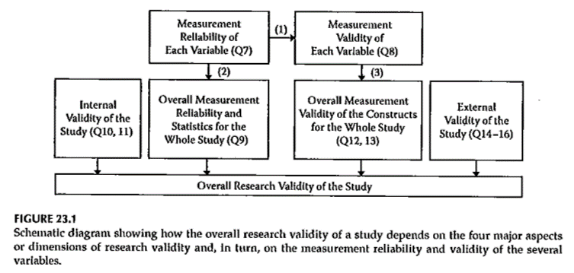
Evaluating Research Validity
7

Slide 8
Evaluating Research Validity
8
GM&L framework document

Slide 9
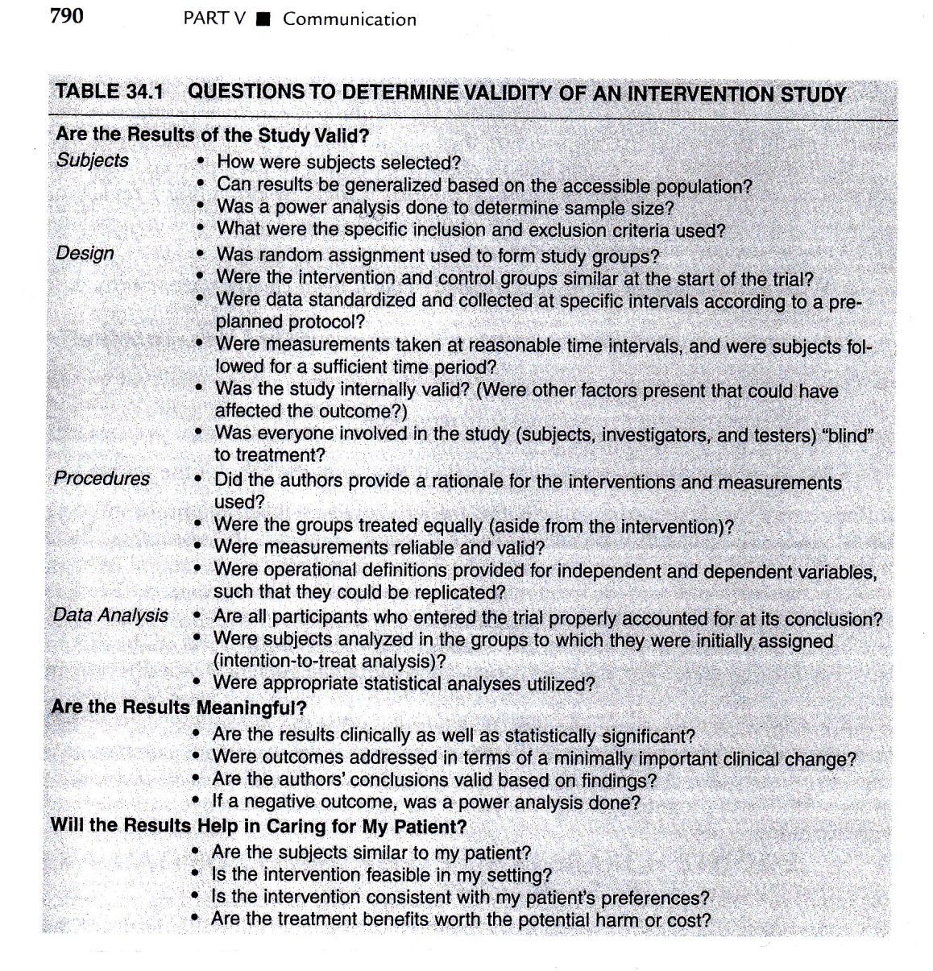
Evaluating Research Reports
Portney & Watkins, 2009
9

Slide 10
Evaluating Research Validity
10
Other Options - examples
MEDB 5511 Literature review form
MEDB 5511 .xls template
Proposal literature review file

Slide 11
Assignment
11
Nothing to be turned in next week
Work on identifying a research topic you want to work on for the final project.

